Slide 1
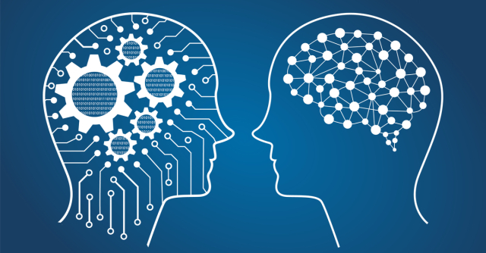
CS 4000 Capstone Introduction Presentation
Haoran Chen u1060286

Slide 2

Background
Name: Haoran Chen
Nationality: Chinese
Current: Bachelor of Science, Computer Science at University of Uath
Bachelor of Electrical and Electronic Engineering with Honours
Capstone Self-introduction

Slide 3
Relevant courses
Data Mining (Using Python & Matlab)
Machine Learning (Current)
Database System (Using MySQL & JSP)
Advanced Algorithms (Current)
Probability & Statistics, Linear Algebra (Both are required in the field)
Capstone Self-introduction

Slide 4
Area of interests
Data Science!
Especially Machine Learning
Using Supervised and Unsupervised Machine Learning Skills to Solve Problems
Research Project on Machine Learning with a professor and a PhD. student
Trained to understand latest academical papers and implement them
Capstone Self-introduction

Slide 5
Concluded Idea
Mobile App on ios
Image Processing on Photos and Videos of Rooms
Study the Processed Data via Machine Learning
Provide Suggestions to the Users on Furniture Placement, etc.
Partner: Experienced in Image Processing via Project
Capstone Self-introduction

Slide 6
Why me?
Enough time for this project (30 Hours or more)
Fast understanding of new knowledge
Enough experience of doing year-long school project
Major GPA 4.0 / Cumulative GPA 3.95
Both my partner and me are targeting to get an A!
Capstone Self-introduction

Slide 7
Thank you for listening !
Name: Haoran Chen
Target: ios app with Image Processing & Machine Learning
Current Group: Pair (Yijie Guo & Me)
Hiring: ios Application Developer, Writing & Speaking Specialized Student
Contact: u1060286@utah.edu, lightairlis@gmail.com
Capstone Self-introduction

